Slide 1

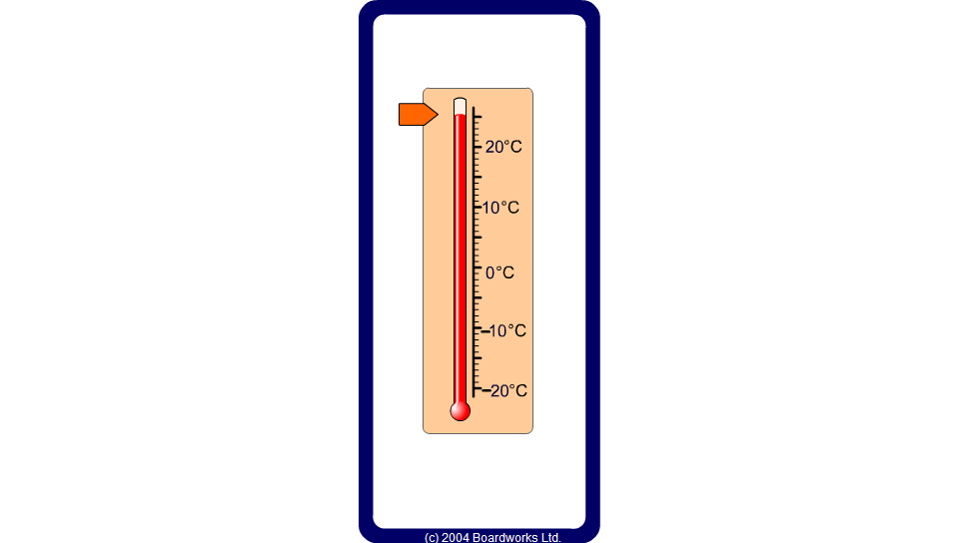


Temperatures
Notes:
Use the slider to point to a variety of temperatures and ask pupils to identify them.
Ask pupils to answer questions mentally and illustrate the answers using the slider.
The temperature is -1°C. It rises by 5°C. What is the new temperature?
The temperature is -13°C. It rises by 17°C. What is the new temperature?
The temperature is -4°C. It falls by 7°C. What is the new temperature?
The temperature is 12°C. It falls by 20°C. What is the new temperature?
The temperature is 6°C. It rises by 10°C and then falls by 18°C. What is the new temperature?
The temperature is -3°C. It falls by 6°C and then rises by 13°C. What is the new temperature?
Links:
S7 Measures - Reading scales

